Slide 1

Data Structures & Algorithms
Week-14

Slide 2
Week-14 Agenda
NP-Completeness

Slide 3
Determinism vs. Nondeterminism
Nondeterministic algorithms produce an answer by a series of “correct guesses”
Deterministic algorithms (like those that a computer executes) make decisions based on information.

Slide 4
NP-Completeness
“NP-Complete” comes from:
  Nondeterministic Polynomial
  Complete - “Solve one, Solve them all”
There are more NP-Complete problems than provably intractable problems.

Slide 5
NP-Completeness
NP-Completeness is a concept in computational complexity theory. A problem is considered NP-complete (NPC) if it satisfies two properties:
  Belongs to NP (Nondeterministic Polynomial time): The problem's solution, if given, can be verified in polynomial time.
  NP-hard: Any problem in NP can be reduced to it in polynomial time. This means that solving an NP-complete problem efficiently would allow all other NP problems to be solved efficiently.
Informally, NP-complete problems are the hardest problems in the class NP, and no polynomial-time algorithm is currently known to solve them.

Slide 6
NP-Completeness
Polynomial Time refers to the computational complexity of an algorithm, where the running time grows at most as a polynomial function of the input size n.
An algorithm runs in polynomial time if its worst-case running time is O(n^{k}), where:
  n is the size of the input,
  k is a constant (e.g., k=1,2,3, etc.),
  O represents the Big-O notation for asymptotic complexity.

Slide 7
NP-Completeness
Examples of Polynomial-Time Problems:
Sorting Algorithms:
  Bubble Sort, Merge Sort, Quick Sort → O(n log⁡ n)
Graph Problems:
  Shortest path in a graph (e.g., Dijkstra’s algorithm) → O(V²)
Matrix Multiplication:
  Standard matrix multiplication → O(n³)

Slide 8
NP-Problems
NP (Nondeterministic Polynomial time):
These are problems where a solution can be verified in polynomial time, even if finding the solution might not be easy.
Example:
Sudoku Puzzle:
  Verifying: If someone gives you a completed Sudoku grid, you can check in polynomial time whether all rows, columns, and blocks follow the Sudoku rules.
  Solving: Finding the solution from scratch may take much longer.

Slide 9
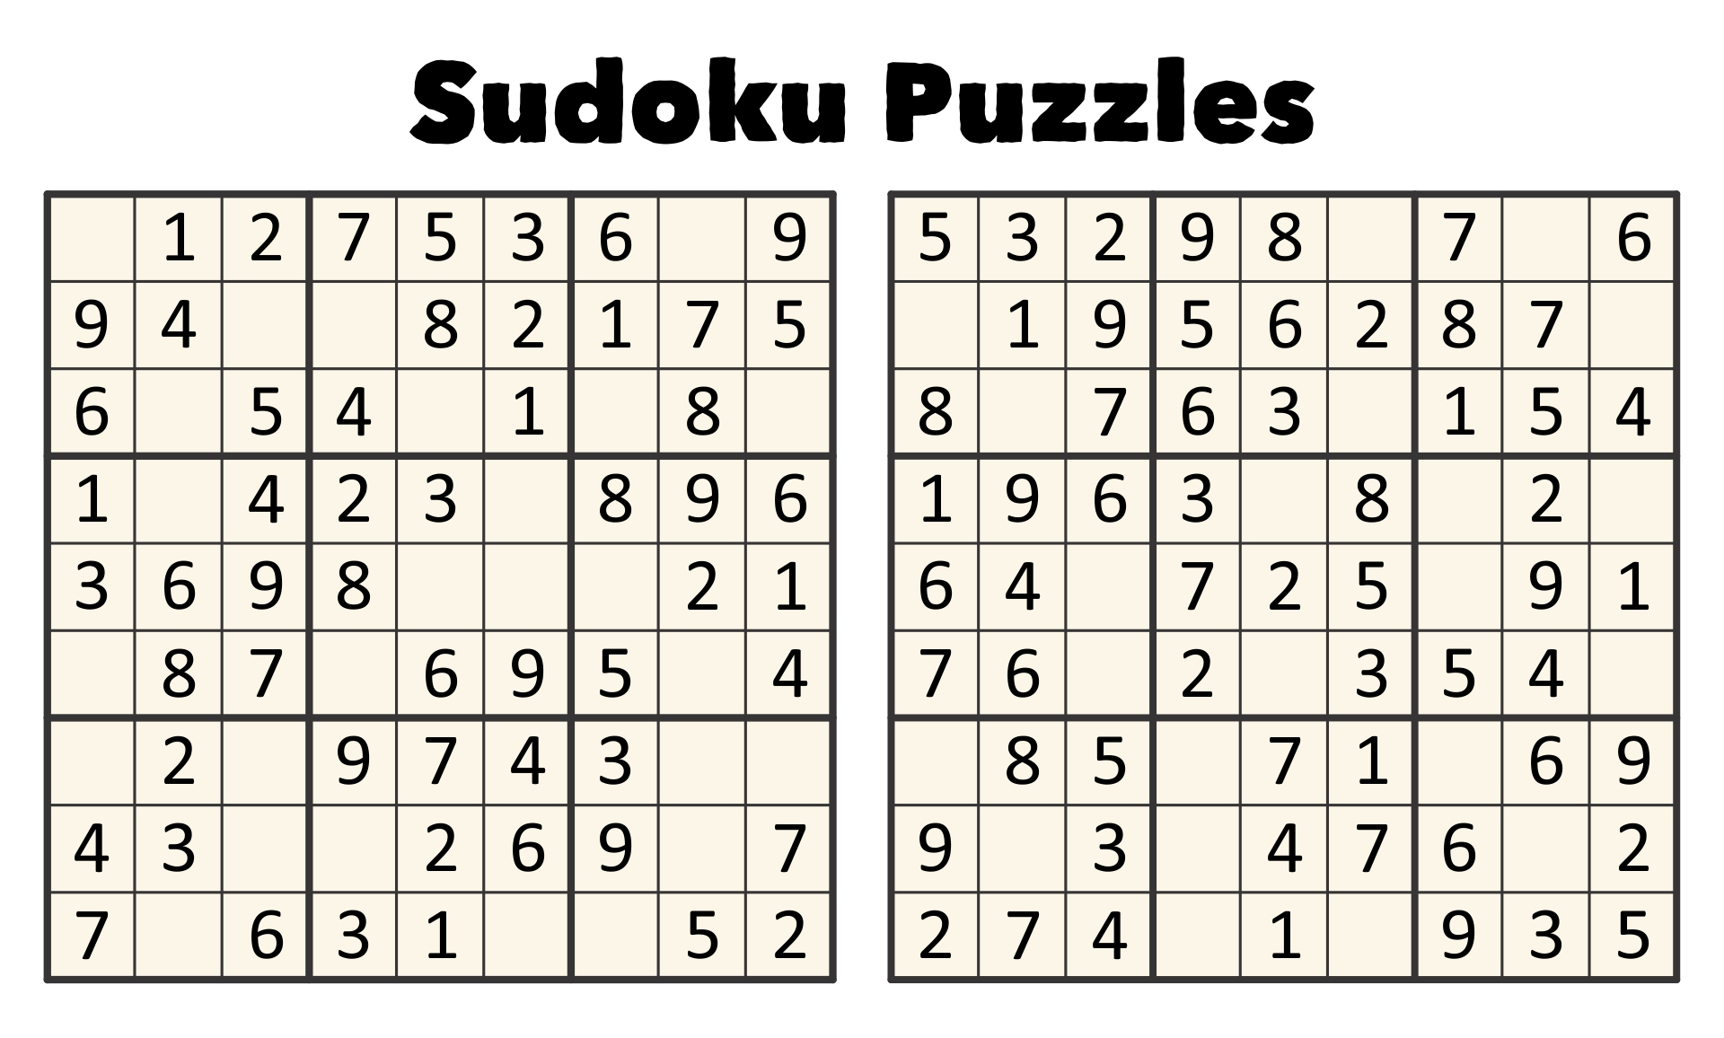
NP-Problems

Slide 10
NP-Complete Problem
NP-Complete:
These are the hardest problems in NP. If you can solve one NP-complete problem in polynomial time, you can solve all NP problems in polynomial time.
Example:
Traveling Salesman Problem (TSP):
  Problem: A salesman wants to visit a set of cities exactly once and return to the starting city, minimizing the travel distance.
  Verifying: If someone gives you a route, you can calculate the total distance in polynomial time and check if it’s valid.
  Solving: Finding the shortest route is computationally hard.

Slide 11
NP-Complete Problem
Path-Finding (Traveling salesman)
Map coloring
Scheduling and Matching (bin packing)
2-D arrangement problems
Planning problems (pert planning)
Clique

Slide 12
Traveling salesman

Slide 13
5-Clique

Slide 14
Map Coloring

Slide 15
Class Scheduling Problem
With N teachers with certain hour restrictions M classes to be scheduled, can we:
  Schedule all the classes
  Make sure that no two teachers teach the same class at the same time
  No teacher is scheduled to teach two classes at once

Slide 16
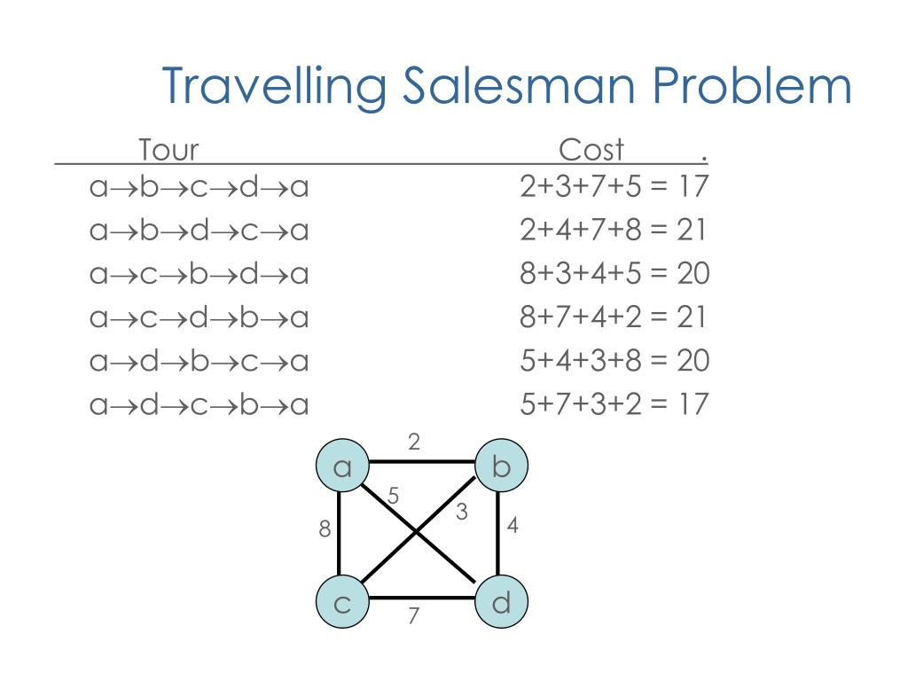
NP-Complete Problem

Slide 17
NP-Hard
NP-Hard:
These are problems that are at least as hard as NP problems, but they don’t have to belong to NP (i.e., they don’t need to have solutions that are verifiable in polynomial time).
Example:
Chess (Optimal Strategy):
  Problem: Determining the best strategy to win a game of chess from any position is NP-hard.
  Verifying: You cannot easily verify a solution, which may involve many future moves.

Slide 18
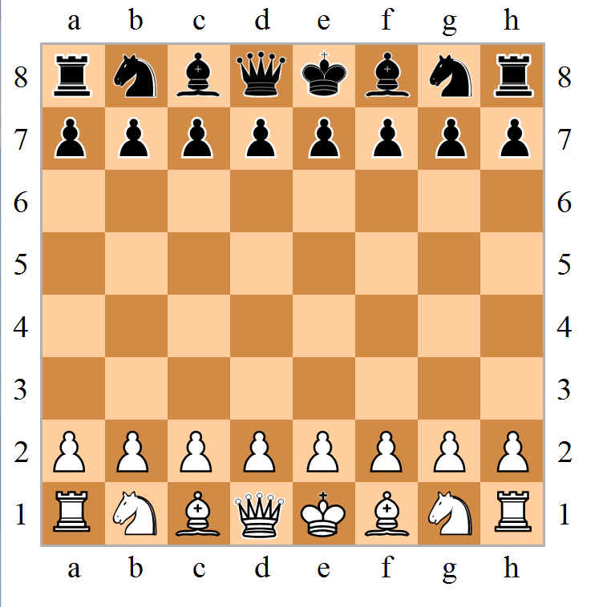

Slide 19
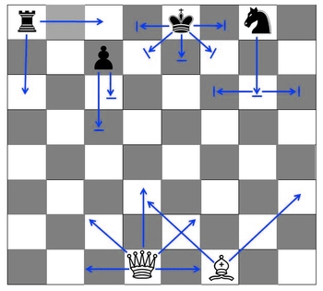
NP-Hard
Most “Hard” problem/programming!

Slide 20
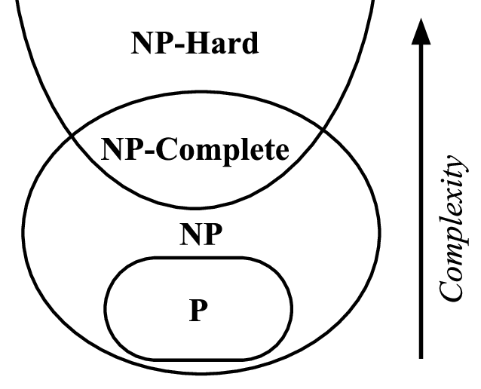
Key Relationship
P ⊆ NP, and NP-Complete problems are the hardest problems in NP, while NP-Hard problems are at least as hard as NP-Complete problems but may not belong to NP.

Slide 21
Key Relationship
P ⊆ NP - All problems in P are also in NP because solving a problem implies you can verify its solution.
NP-Complete ⊆ NP - NP-Complete problems are the most challenging problems in NP.
NP-Hard ⊇ NP-Complete - NP-Hard includes NP-complete problems but may also include problems outside NP.

Slide 22


